Slide 1
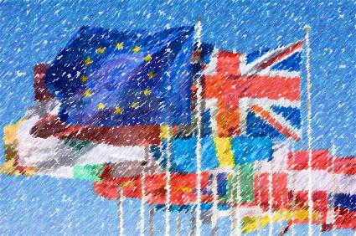


HUNGARY and CROATIA – Current issues in tourism
presented by
Mr Marin SKENDEROVIĆ
Head of Branch Office
Croatian National Tourist Board in Budapest
Budapest, 18th June 2013

Slide 2
Major emitive markets/tourist arrivals
RANKING | 2012 | 2011 /2012
1. Germany | 1 941 920 | 12,56%
2. Slovenia | 1 151 742 | -2,68%
3. Austria | 1 010 033 | 5,96%
4. Italy | 966 708 | -6,28%
5. Czech Republic | 693 497 | 3,35%
6. Poland | 576 357 | 11,72%
7. France | 423 643 | 5,20%
8. Slovakia | 361 369 | 5,27%
9. The Netherlands | 341 882 | 16,18%
10. UK | 332 882 | 23,44%
11. Hungary | 332 015 | -3,39%

Slide 3
Major emitive markets/tourist overnights
RANKING | 2012 | 2011 /2012
1. Germany | 14 953 105 | 13,41%
2. Slovenia | 7 422 590 | 0,38%
3. Austria | 5 687 163 | 6,33%
4. Czech Republic | 4 851 610 | 4,68%
5. Italy | 4 758 591 | -6,53%
6. Poland | 3 685 103 | 10,93%
7. The Netherlands | 2 638 095 | 14,77%
8. Slovakia | 2 463 299 | 5,14%
9. Hungary | 1 811 175 | -3,96%

Slide 4
Hungarian tourist arrivals to Croatia - (thousand)
1995–2012

Slide 5
Hungarian overnights in Croatia
(thousand)
1995–2012

Slide 6
Proportion : population and those travelling to Croatia
Country | Population | Visitors | %
Slovenia | 2.055.496 | 1.151.742 | 56,03
Austria | 8.443.018 | 1.010.033 | 11,96
Czech Republic | 10.504.203 | 693.497 | 6,60
Slovakia | 5.410.000 | 361.369 | 6,70
Hungary | 9.958.453 | 341 882 | 3,33

Slide 7
Proportion : population and those travelling to Croatia

Slide 8
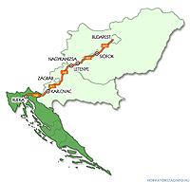
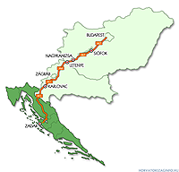
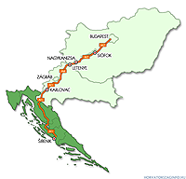
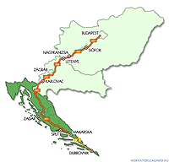

Distances from Budapest
Rijeka: 680 km
Sibenik: 680 km
Zadar: 620 km
Split: 850 km
Dubrovnik: 1040

Slide 9
COMPARATIVE ADVANTAGES OF CROATIA FOR HUNGARIAN TOURIST
1., PROXIMITY (BEING FAMILIAR WITH THE SITUATION, THE OPPORTUNITY TO MAKE DECISION AT THE LAST MOMENT
2., COMMON HISTORY AND PAST EXPERIENCES; THE SAME VALUE SYSTEM
3., PERSONAL SAFETY AND BEING WELCOMED

Slide 10
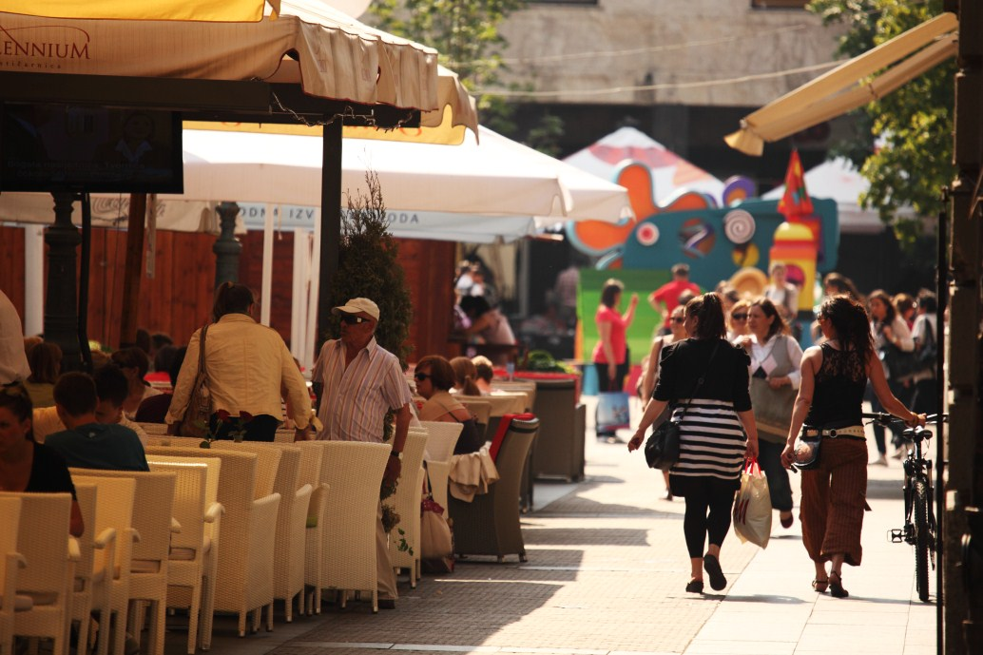
Galupp Balkan Monitor 2012 July SURVEY
For Croats:
Hungary – the best neighboring country
Hungarians – the most favourable neighboring people

Slide 11
Hungarian tourist outbound trips in 2012

Slide 12
Hungarian tourist outbound trips in 2012 by seaside destination countries
Source:KSH

Slide 13
Tourist arrivals and overnights
January-May 2013
 | Tourists | 2012/13 % | Overnights | 2012/13 %
TOTAL | 1.932.338 | 7,22 | 6.749.499 | 10,53
- Foreigners | 1.585.666 | 8,95 | 5.783.575 | 11,46
- Domestic | 346.672 | -0,07 | 965.924 | 5,28
- Hungary | 21.459 (current ranking: 13.) | -4,81 | 71.306 (current ranking: 17.) | -0,29

Slide 14


TOMAS SURVEY-
HUNGARIAN TOURISTS IN CROATIA

Slide 15
AGE; EDUCATION; DOMICILE; TRAVEL PARTY; MOTIVATION
Age
30-49 (59%)
Domicile
Town of 10.001-100.000 inhabitants (39,75%)
Education
High school degree (35,3%)
Travel party
Family (56,3%)
Motivation
Rest and relaxation (70,1%)

Slide 16
LOYALTY; SOURCE OF INFORMATION; ORGANIZATION; TIME OF BOOKING
To Croatia
3-5 times (38,2%)
Destination
1st time (46,4)
Accomodation
1st time (63,8%)
Previous visits
(33,9%)
Internet/CNTB
(48,2%)
Tourist agency
(35%)
Individual
(65%)
Time of booking
5-8 weeks in advance (36,7%)

Slide 17
OVERNIGHTS; No. OF ACCOMODATION; MEALS; EXCURSIONS
Overnights
4-7 overnights (45,8%)
Number of accomodation facilities used
1 (90,1%)
Meals
Out of accomodation facility (76,6%)
By excursions
Individual
(43,1)

Slide 18
ACTIVITIES; SATISFACTION FACTOR;
Activities
swimming/bathing (99,5%)
cafe-bars, cake shops (93,2%)
restaurants (88,5%)
Satisfaction factor
Personal safety (55,9)
friendly prices (55%)

Slide 19
AVERAGE
EXPENDITURE (€)
 | Total expenditures | Expenditure of arrival/travel | Cost of tourist agent | Expenditure at destination | Number of tourist/average | Overnights
Total | 528,04 | 74,97 | 23,03 | 430,04 | 3 | 8,2
Organized trip | 554,06 | 69,05 | 69,85 | 415,16 | 2,9 | 7,5
Individual trip | 515,25 | 77,89 | - | 437,36 | 3,1 | 8,5
Car arrival | 500,44 | 69,10 | 25,29 | 406,06 | 3,1 | 7,9

Slide 20
Hungarian tourist arrivals/CLUSTERS– 2012

Slide 21
Hungarian overnights/CLUSTERS– 2012

Slide 22
Average number of Hungarian tourists in Croatia/by month

Slide 23

THANK YOU FOR YOUR
ATTENTION!

